Slide 1
Website Ad-Click
Once the company launch their website , in order to increase their revenue they have to do advertisements, but it will results in more costs . So in order to decrease their costs they can check whether the customer check their website by clicking on it This helps promote your website by boosting its search engine ranking, increasing the chances that they’ll get paid by Google by drawing traffic to Google ad on the website.

Slide 2
OBJECTIVE
To predict the number of Ad clicks the user did on a Company website . The data used to analyze the above features is loaded into the advertising.csv. Basically Logistic Regression model is used to solve such kind of problems, because logistic regression predicts discrete categories. The main goal is to interpret the results of the logistic regression through confusion matrix by predicting whether or not user clicks the Advertisements while they are using the sites.

Slide 3
DATASETS
' Time Spent on ': consumer time on site in minutes
'Age': customer age in years
'Avg Income': Avg. Income of geographical area of consumer
‘ Internet Usage': Avg. minutes a day consumer is on the internet
'Ad Topic ': Headline of the advertisement
'City': City of consumer
‘Male': Customer is male or not
‘Clicked': Whether the customer clicked or not

Slide 4
TARGET VARIABLE
Out of these columns we have a target variable and that is ”CLICKED”

Slide 5
SIGNIFICANT VARIABLES
From the above variables , there are some variables which are not useful in predicting the business result so we have to remove those columns .
Time_Spent
Age
Avg _income
Internet_Usage
Male
Clicked

Slide 6
Continuous VS Categorical Variable
Categorical Variable = The value is limited and usually based on a particular finite group. For example gender , year.
Continuous Variable = This variable can take any value from integer to decimal . For example revenue , price of share

Slide 7
UNIVARIATE ANALYSIS
In univariate analysis we have two parts
In case of Categorical Variable we have a bar plot .
In case of continuous variable we have made histogram.

Slide 8
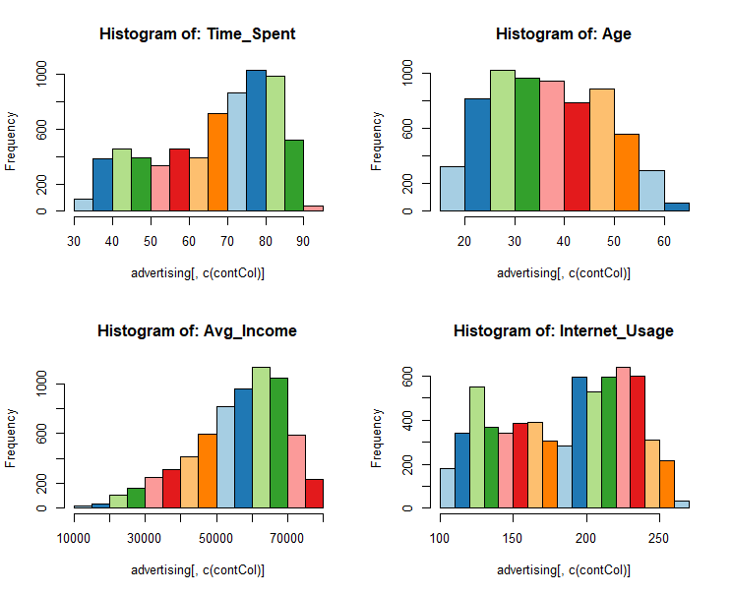
Histogram for Continuous Variables

Slide 9
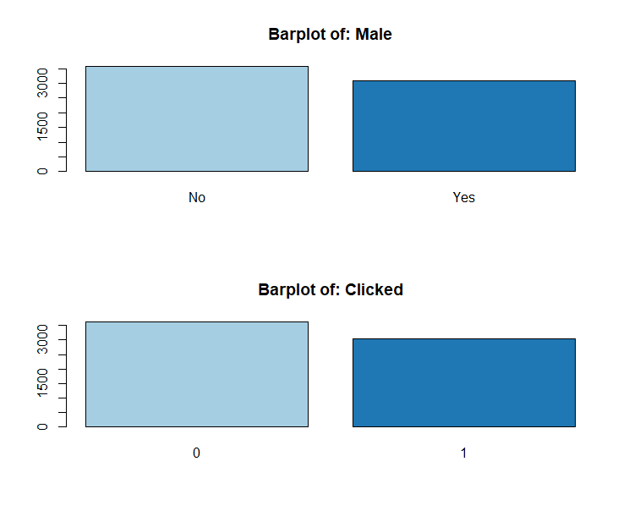
BAR PLOT for Categorical Variables

Slide 10
BIIVARIATE ANALYSIS
Its a visual relationship between predictors and target variable
Continuous Vs Continuous ------- Scatter Plot
Continuous Vs Categorical ---------Bar Plot

Slide 11
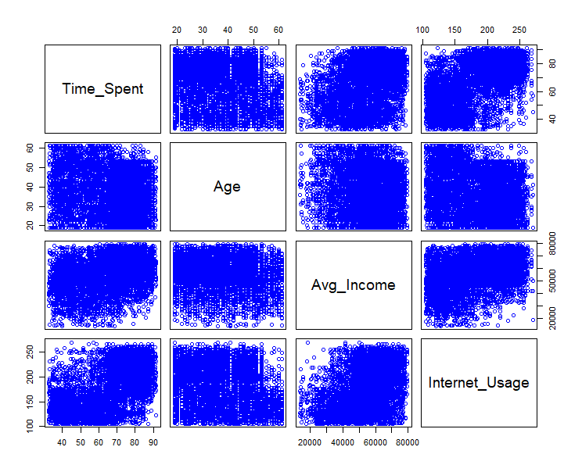
SCATTER PLOT

Slide 12
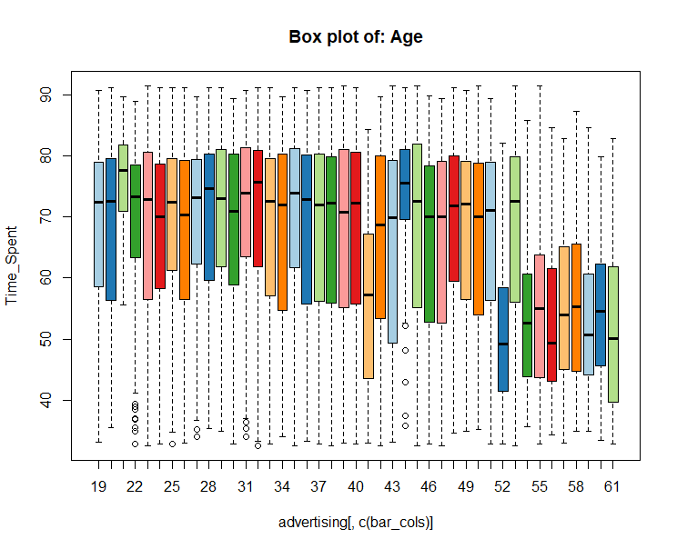
BAR PLOT – AGE

Slide 13
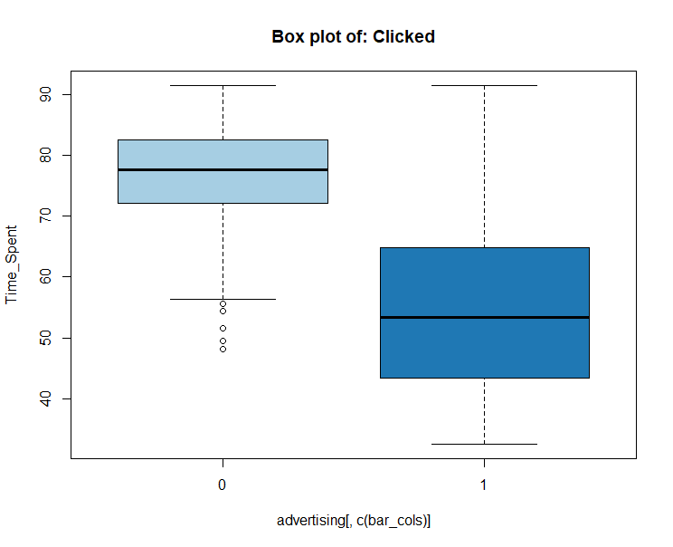
BAR PLOT- CLICKED

Slide 14
MODEL BUILDING
In order to build the model we have firstly split the data into training and test into 70% and 30% respectively.
As this is the case of logistic regression we have build the model using glm()

Slide 15
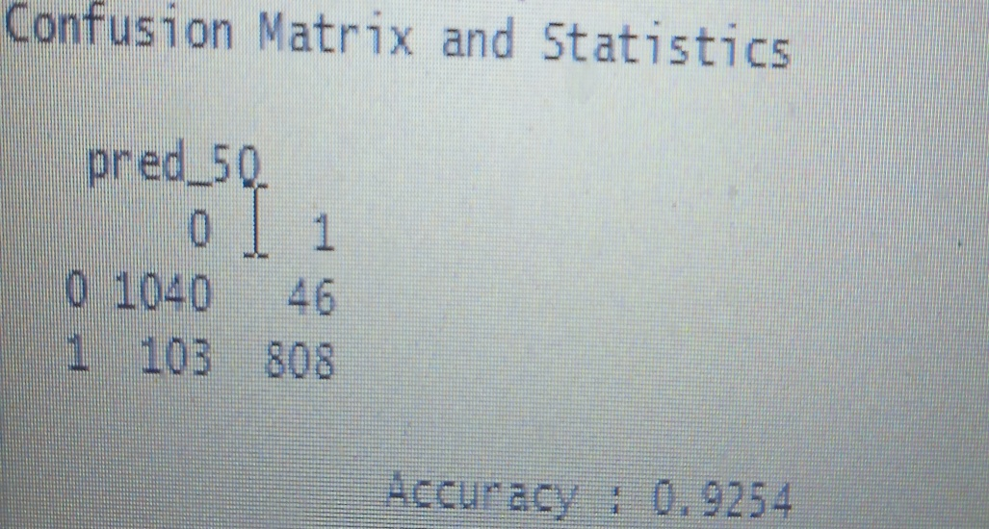
Confusion Matrix
After building the model we have now created the confusion matrix , with the threshold of 50%
With this threshold , we are getting accuracy of 92%, which is very good .
Sensitivity = 90%
Specificity=94%
Balanced =92%
accuracy

Slide 16
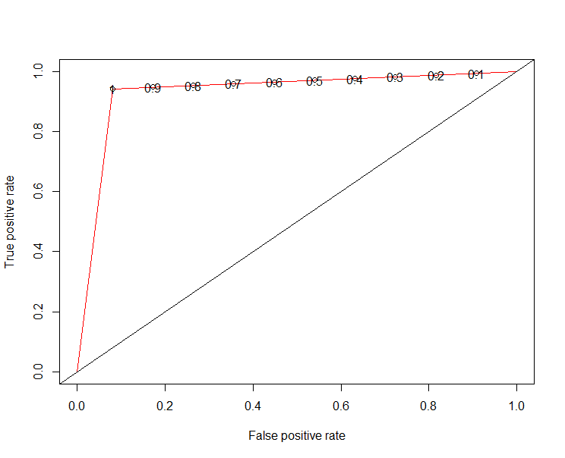
K fold Method ROC- AUC

Slide 17
THANK YOU.

